Slide 1
University of Detroit Mercy
President’s Convocation
Academic Accomplishments and
Facility Updates

Slide 2
Accomplishments of Schools/Colleges/Units

Slide 3
School of Architecture
Enrollment: The School of Architecture continues to enjoy steady enrollment growth. Our headcount this fall is at its highest level since 2011, with an increase of 32% over the past 4 years.
Study Abroad: The Volterra Detroit Foundation, which was established in 2010 to facilitate the renovation of our Volterra International Residential College, received a very significant donation from Detroit Mercy Alumni Steven and Beth Pagnotta. Their gift allowed the Foundation to fully retire the construction debt from the renovation of this historic facility, which will free up operational income to support student scholarships.
Fitzgerald Developments: A group of architecture students developed a design over the summer for a new pocket park in the Fitzgerald neighborhood. Later this fall we hope that several of these students will have the opportunity to actually build a small pavilion in the park that they have designed. And the Detroit Collaborative Design Center is about to complete the renovation of a new storefront office on McNichols, which will house the Live6 Alliance, DCDC staff, staff from the City of Detroit Planning Department, and representatives from the development groups working in the Fitzgerald Neighborhood.

Slide 4
College of Business Administration
For the fourth consecutive year, U.S. News & World Report has ranked both our undergraduate and graduate Business Management programs among the top 25 in the entire nation.
Four of our business majors placed among the top 25 investors in the ETF Global Portfolio Challenge, collectively outperforming all other universities worldwide.
Fr. Jerry Cavanagh, S.J., was acknowledged as a founder of the field of business ethics, and Dean Eisenhauer was ranked among the world’s top scholars in the field of risk management & insurance over the past quarter-century.

Slide 5
School of Dentistry
In May 2017, the School reorganized the clinical education model to one that promotes primary care, centric patient management, and treatment teams. Expected results include improved learning outcomes, patient satisfaction, and productivity.
The School of Dentistry finalized the six partner sites for the Michigan Department of Health and Human Services grant awarded to develop a pilot program to increase access to dental services to pregnant women. Cities in the east region include Battle Creek, Bay City, and Lansing, while the west region includes Muskegon, Benton Harbor and the Upper Peninsula. Improved oral health in pregnant women may lead to improved birth outcomes and decreased dental disease in infants.
The School of Dentistry is negotiating details to partner with Covenant Community Care and Trinity Health and Holy Cross Services at their health center site at 17625 Joy Road in Detroit. This project is a redevelopment of the land previously occupied by Herman Gardens. The campus will provide comprehensive health and life skills development. Occupancy is planned for May 2019.

Slide 6
College of Engineering & Science
In partnership with Automation Alley and sponsored by Ford Motor Company, E&S is spearheading a two-year research project on Industry 4.0 and advanced manufacturing technologies. The 2018 Technology In Industry Report (https://automationalley.com/techreport) with Detroit Mercy as a primary organizer/sponsor was released at an event at the Detroit Institution of Arts on April 30, 2018. The project continues into the next year with additional academic partners and industry partners.
Detroit Mercy's College of Engineering and Science and the Louis Stokes Midwest Center of Excellence (LSMCE) recently signed a collaborative agreement to increase the number of under-represented minority students in the fields of science, technology, engineering and math (STEM). Together, along with other universities, the institutions will collaborate to increase student success and retention of under-represented groups in STEM to help address the nation’s critical need for scientists and engineers.

Slide 7
College of Health Professions/ McAuley School of Nursing
A minor in Health Information Management was approved by both the McNichols Faculty Assembly and the Academic Leadership Team. The minor will consist of health information management classes in medical coding, healthcare quality and statistics, and clinical documentation.
All PA students from the Class of 2017 have taken their certification exam (PANCE) and passed. We have 100% pass rate this year.
The NA team is proud to report that the doctorate level nurse anesthesia transition is moving forward nicely. The plan to enter the last Master’s level cohort and the first doctoral level cohort in September 2019.
Two MSON faculty members traveled to Volterra, Italy to initiate study abroad for undergraduate nursing students.
Family nurse practitioner students continue to have 100% pass rate on the national certification exam and the graduate nursing programs were highly ranked in the US News & World Report.

Slide 8
School of Law
Detroit Mercy Law had the second highest pass rate in the state for the February 2018 Bar Exam.
90% of the law school’s 2017 graduates were employed within 10 months of graduation in legal and professional positions.
The law school will offer a new online, non-JD Certificate in Law focused on Intellectual Property (having received approval from the Higher Learning Commissions and the American Bar Association) developed specifically to address the increasing demands on individuals and organizations to safeguard their IP assets such as inventions, marks, technological innovations and artistic works. More information is available at http://law.udmercy.edu/academics/non-jd-certificate-program/

Slide 9
College of Liberal Arts & Education
Completion of the first active learning classroom that facilitates collaboration and group work with three easily rearrangeable desks, 144 square feet of write-on glass boards and three screens. Made possible by a generous gift from Jamie and Robert Dylenski.
Three successful study-away summer programs: The Civil Rights Movement travel course through Alabama, Mississippi and Tennessee (led by Professors Finkenbine and Sumner), New York City theater program (led by Prof. Greg Grobis), and five-week Fulbright experience in Brazil (led by Lara Wasner).
Receipt of national accreditation for the Social Work program for a maximum term of seven-years with no deficiencies or suggestions.

Slide 10
University Libraries and Instructional Technology
The McNichols Campus Library has completed a refresh of the 1st floor. Improvements include new carpet and furniture, additional group study rooms, additional power outlets, accessible inclusive restrooms, a mothering room, and Metz updated and expanded café “The Bookmark.” This project was completed in partnership with Facilities Operations, ITS, Public Safety, University Services, and Metz.
Students asked, and we listened: The McNichols Campus and the School of Dentistry Libraries have expanded hours for students. Beginning September 10th, the McNichols Campus Library's 1st floor will be open to students Monday-Thursday until midnight. The School of Dentistry Library offered extended hours during Summer exams, and will extend exam week hours in the Fall, as well.
The Instructional Design Studio (IDS) recorded record-breaking enrollment for their Summer Workshop series. Workshops were developed in response to faculty feedback and included topics such as augmented and virtual reality and developing engaging lectures.

Slide 11
Institute for Leadership and Service
The National Society for Leadership and Success - Through a partnership between the Institute and Student Affairs, a new chapter of the National Society for Leadership and Success was launched this past August. The criterion for membership in the Society is Sophomore status, greater than 3.0 GPA, and active participation in the Emerging Leaders Program and/or the Leadership Minor. 552 students have joined and 206 have officially been inducted into the Society. The requirements for induction include participation in Leadership Seminars, Public Speaker Broadcasts, and Success Networking Seminars. This national recognition compliments our Detroit Mercy local recognitions of the Emerging Leaders Programs’ Leadership Pin and Medallion awards.
Emerging Leaders Program (ELP) - Program activities and events have resulted in the recruitment of over 200 new engaged members to the Emerging Leaders Program. The partnership with ELP and the office of Advancement resulted in three major gift donors participating in the ELP Leadership Slams. These speaking events allowed Joe Zalke, Major General Gerry Cannon, Peter Sullivan, Larry Angelilli, Tom Lokar, and Tom Page the opportunity to share their leadership stories and to engage our students in networking and learning opportunities. In addition, at the University Honors Convocation in March, 21 students received the recognition of the Leadership Medallion and Leadership Pin awards.
Step Up: Be a Leader and Pay It Forward - 85 undergraduate Emerging Leaders enrolled in the Leadership Capstone courses, participated as group mentors in the student-led Step Up Program that provides leadership, social skill, and college transition information modules to local students high schools in Hamtramck Public Schools’ HOPE After School Program, the Jalen Rose Leadership Academy, and other education partners. Five FCCP Student Leaders organized the 85 Detroit Mercy students and together facilitated 50 separate 1.5 hour sessions for over 200 younger students. Several of the Detroit Mercy students so enjoyed the experience and leadership growth that they plan to return to the program next year, even though they will no longer be part of the Capstone course.
Leadership Minor - The Leadership Minor continues to thrive on campus with over 500 students declaring this Minor and representing more students than all other minors combined. This interdisciplinary program coordinates with every major on campus and augments the leadership capacity and campus experience for our students. Leadership Minor students also play key roles in every campus organization and contribute significantly as volunteer coordinators for Commencement, Freshmen Move-In Day, and our annual Homecoming.

Slide 12
Institute for Leadership and Service
22 Student Leaders in the Ford Community Corps Partnerships program developed creative service-learning projects that served over 4,000 people in our community.
18 Students designed and built a new learning station (an Earthquake table – that allows kids to build Lego structures and test how well they would withstand an earthquake) for the Michigan Science Center.
Junior Sarah Hirschmann led 13 students in developing card games that helped the special education students develop their math skills.
19 MBA students created a business plan to help Southwest Solutions make critical business decisions related to starting their own construction business.
5-Year MBA student, Melba Dearing developed a business plan for creating marketable products using the food that Campus Kitchen recovers.
Student Leader Dohna Dudley created a plan for an on-campus Food Pantry that is on track to open in the fall to help Detroit Mercy students who experience food insecurity. (The Student Social Work Association surveyed Detroit Mercy students and found that 42% of Detroit Mercy students or their households did not have enough food to eat, and 51% said their food supply had been inadequate during the semester.)

Slide 13
TRIO Student Support Services
TRIO SSS offered over 25 skill development workshops throughout the academic year, which included topics such as financial literacy, academic success planning, and graduate school preparation.
A priority service offered by TRIO SSS included providing assistance to TRIO participants with applying for admission to graduate schools. To meet this need, TRIO SSS took students on graduate school and cultural immersion tours in Michigan, Illinois, and Indiana, visiting 20 universities, 5 museums, and participating in multiple career presentations. TRIO SSS had over 1,700 visits from students and logged over 1,300 student study hours.
Additionally, TRIO implemented 4 summer enrichment programs to assist students with preparing for course content and their transition to University of Detroit Mercy. TRIO provided more than 20 scholarships to 1st generation, income-eligible, and students with disabilities, which assisted with the provision of the critical financial assistance that students need to complete their education.

Slide 14
TRIO Upward Bound
University of Detroit Mercy’s TRIO Upward Bound program is moving forward in its efforts to empower student’s from Frederick Douglass Academy for Males and Osborn High School to succeed academically, and socially, while providing experience culturally enriching experiences to its students. TRIO Upward Bound is also providing programming which maximizes the potential for growth and success as it pertains to increasing grade point averages and SAT or ACT scores. Over the course of its existence at the University of Detroit Mercy, students have participated in the following:
Academic enrichment, including Math, Chemistry, English Language Arts, Creative Writing and Spanish;
Study skills and life skills enrichment, including but not limited to teambuilding and fitness activities, financial literacy, presentation skills, career development, college awareness and preparedness, SAT online prep coursework, leadership skills, one on one and group tutoring, and work readiness and etiquette;
One on one and group sessions with a licensed school and clinical psychologist, Weekly Lunch and Learn In-School workshops, cultural enrichment tours, including a historical riverboat tour, tours of the Milliken State Park’s wetlands, Detroit River Walk, Underground Railroad Monument and historical tours of the Eastern Market, Guardian building, Campus Martius Park, a tour of the University of Detroit Mercy’s campus, and Summer stipends through TRIO Upward Bound and the Grow Young Detroit’s Talent Program through the City of Detroit; and
Program provided transportation, breakfast and lunch, and parental communications conducted via weekly and bi-weekly phone conversations.

Slide 15
Athletics
All 19 Titan teams posted multi-year scores above the 930 NCAA qualifying mark for the sixth straight year, with men’s fencing achieving a perfect score of 1,000, three teams were above 990 and nine teams were above 980 in the latest data.
Women’s Lacrosse had one of its top seasons in the 10-year history of the program with a 10-8 overall record. The team earned a share of the inaugural Southern Conference regular-season championship which is its first ever as a program.
Men's tennis had a historic season in pursuit of their first-ever bid to the NCAA Tournament but fell short in a 4-2 loss to Cleveland State in the Horizon League Championship. They also earned a share of the Horizon League regular-season title for the first time in school history.

Slide 16
Facility updates

Slide 17
Library Renovation
The intent of this project was to provide more comfortable study areas, an improved food serving experience and to allow extended hours for the Library. The project included 2 new 1st floor restrooms as well as a mothering room. Other new features include furniture, additional electrical outlets, a secure vestibule with card access, a new drinking fountain with a bottle filler and new flooring.

Slide 18
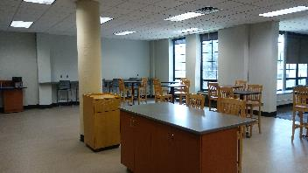
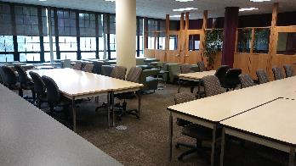
Library Renovation

Slide 19
Briggs 105
The intent of this project is to provide a collaborative learning space and set the stage for future classroom renovations in Briggs. This project will create a flexible learning environment with features such as new moveable desks, glass marker boards, metal wall panels and multiple wall mounted monitors.

Slide 20
Briggs 105

Slide 21
Briggs 105

Slide 22
Assistive Technologies Lab
This project created a new lab for the Assistive Technologies Department from underutilized machine shop space. This Lab includes new cabinets, furniture, work benches, lighting, epoxy flooring, new doors and electrical outlets.

Slide 23
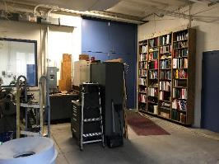
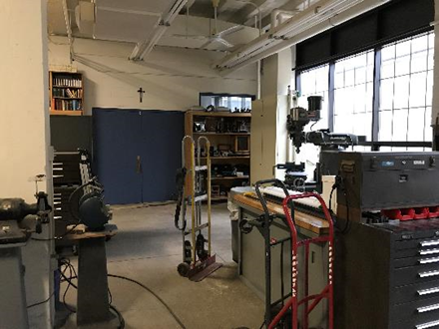
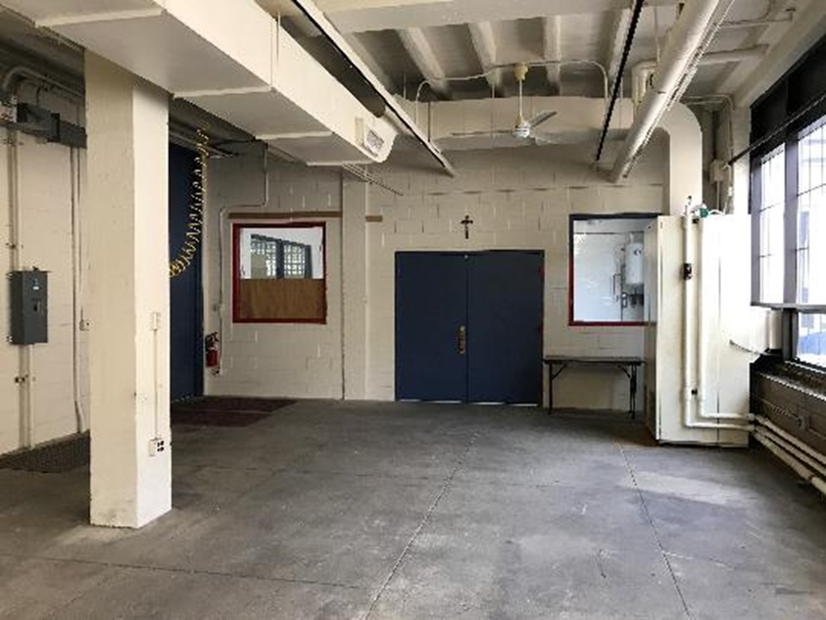
Assistive Technologies Lab

Slide 24
Assistive Technologies Lab

Slide 25
Engineering Room 140
This project renovated classroom E-140 in the Engineering Building on the McNichols Campus. The project provided an updated but traditional style teaching space that can hold up to 60 people. The work included new glass marker boards, two large teaching wall display monitors along with new carpet, paint, lighting, furniture and air conditioning.

Slide 26
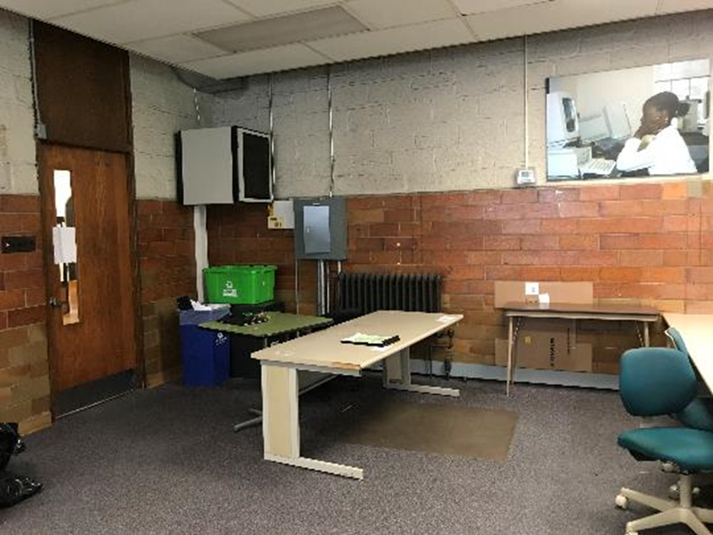
Engineering Room 140

Slide 27
Engineering Room 140

Slide 28
Engineering Center for Innovation
This Center for Innovation is a new collaborative maker space that will be located at the East end of the High Bay. A large glass façade will allow more natural light to flow into the High Bay and provide an inviting transparent aesthetic feature. This flexible space will utilize movable furniture for students to create collaborative groups. Some features to be included will be glass marker boards, air conditioning, updating lighting, carpet and paint.

Slide 29
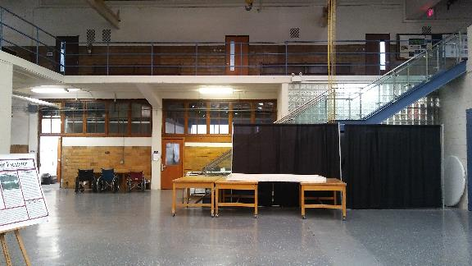
Engineering Center for Innovation

Slide 30
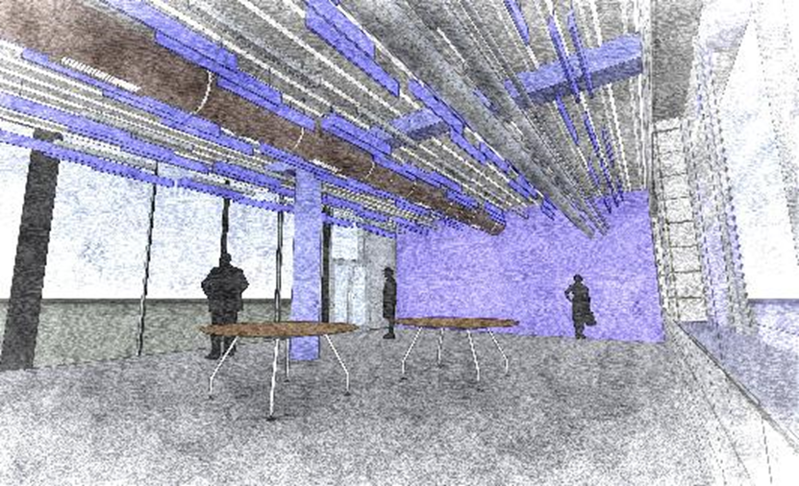
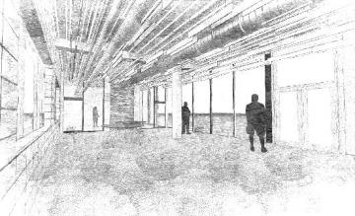
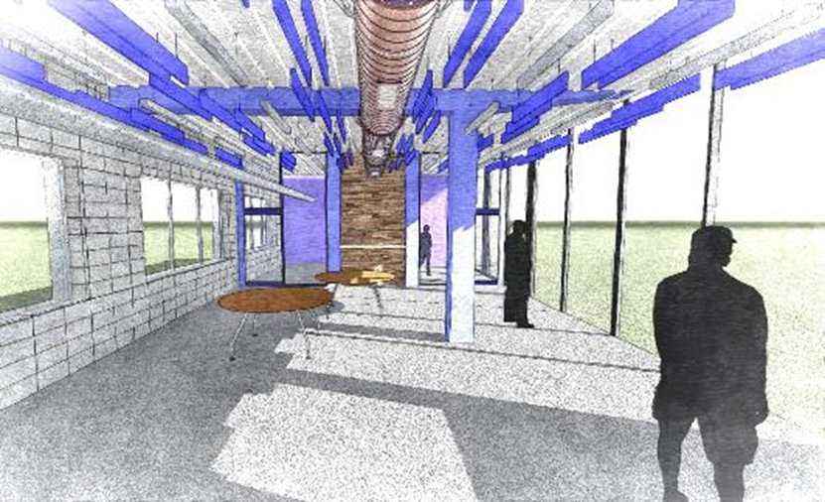
Engineering Center for Innovation

Slide 31
Engineering 1st Floor Corridor and Lobby Renovation
The purpose of this project is to create a brighter more inviting corridor and student study/lounge area. The project will create a more accessible and useable space with features such as a bar height counter top for both study space and small events, lounge furniture, and new lighting and paint throughout the first floor common areas.

Slide 32
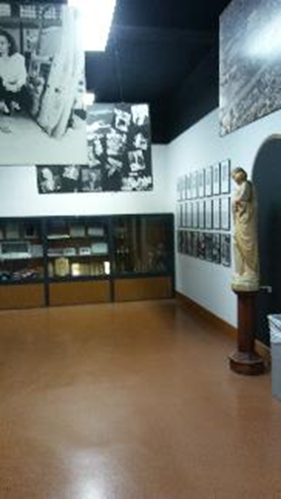
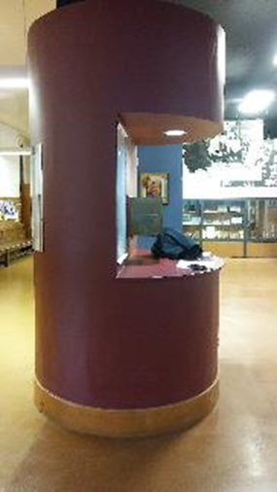
Engineering 1st Floor Corridor and Lobby Renovation

Slide 33
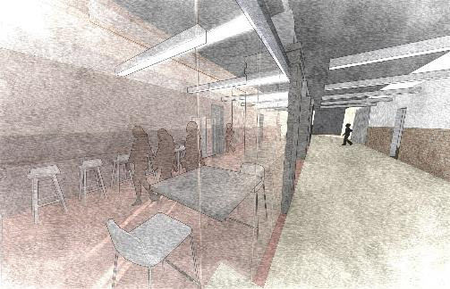
Engineering 1st Floor Corridor and Lobby Renovation

Slide 34
Men’s Basketball Locker Room
This project updated the Men’s Basketball locker-room in Calihan Hall to include new wood lockers, a new kitchenette with sink, counter and fridge, new flooring, sliding marker boards and paint.

Slide 35
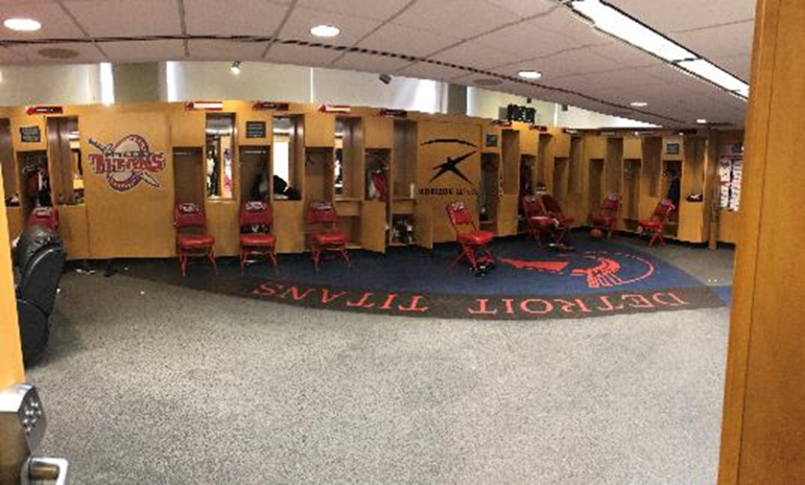
Men’s Basketball Locker Room

Slide 36
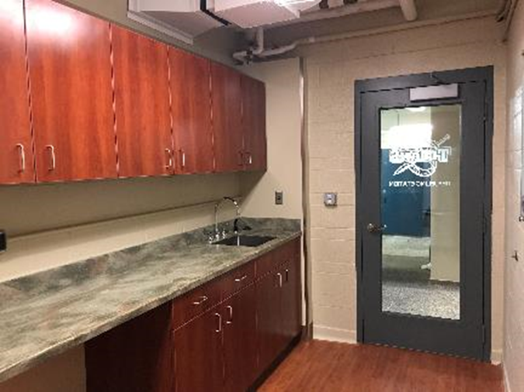
Men’s Basketball Locker Room

Slide 37
North Quad Bathrooms
This project was a complete upgrade of the 32 North Quad bathrooms as well as a complete update to the fire alarm system. Each bathroom received new plumbing fixtures, lights, tile floors, showers, countertops and improved electrical outlets. The project included 30 standard bathrooms and 2 barrier free restrooms.

Slide 38
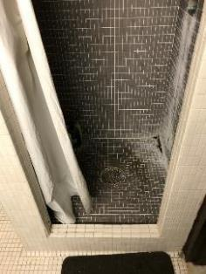
North Quad Bathrooms

Slide 39
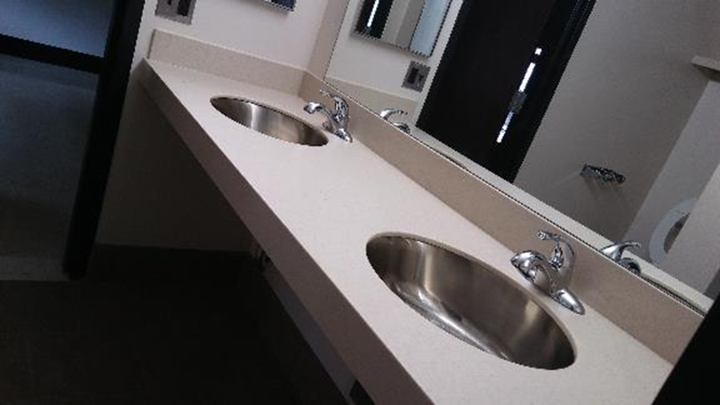
North Quad Bathrooms

Slide 40
Poblanos
This project added a new dinning option for both students and employees. Poblanos now occupies an underutilized space in the loft serving area using custom stainless steel counters, new food service equipment and a new build your own soda fountain by Coke.

Slide 41
Poblanos

Slide 42
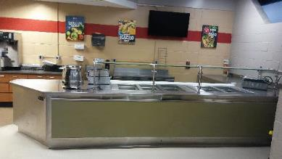
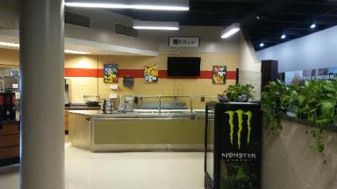
Poblanos

Slide 43
Facilities Storage Building
A new donor funded storage building was built in the Facility Operations yard to provide sheltered space for vehicle and material storage. The building is 5,400 square feet with 16’ high ceilings.

Slide 44
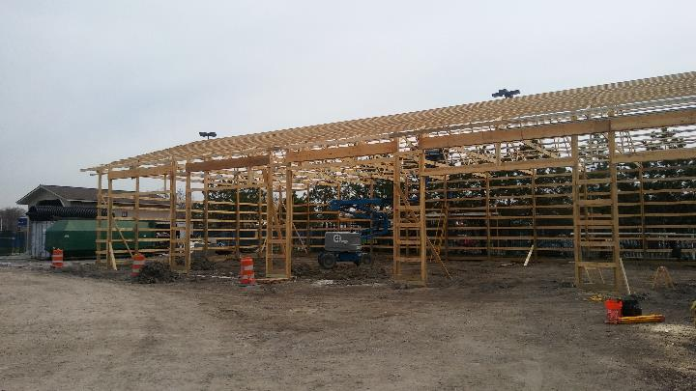
Facilities Storage Building

Slide 45
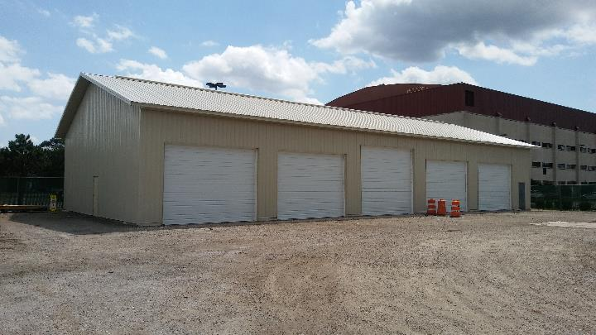
Facilities Storage Building

Slide 46
Main Campus Central Parking Lot
This project will create a new 58 car parking lot north of the Fitness Center. The project will include new underground drainage, additional lighting, and a new dumpster enclosure.

Slide 47
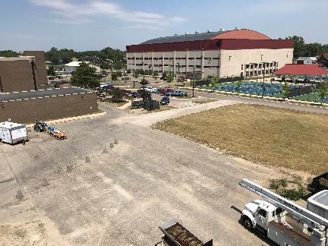
Main Campus Central Parking Lot

Slide 48
Main Campus Central Parking Lot

Slide 49
School of Dentistry Atrium
Construction for the School of Dentistry Atrium is tentatively scheduled to begin in Fall 2018. This project will include enclosing an existing courtyard to create an exciting new 3 story glass and steel enclosure to construct a more grand entrance. Project will include new terrazzo floors, furniture, LED lighting, self-serve check in and a new galvanized steel building façade.

Slide 50
Dental Atrium

Slide 51
Dental Atrium

Slide 52
Dental Atrium

Slide 53
School of Dentistry Faculty Practice
The renovation of the existing Faculty Practice space allowed for the addition of 4 new dental chairs and a more efficient use of the space. The work included new flooring, counters, laboratory casework, leaded glass dividers, and new electrical upgrades.

Slide 54
Faculty Practice

Slide 55
Faculty Practice

Slide 56
School of Dentistry IT Service Center
This project removed a single underutilized restroom to expand the IT Service Center to provide additional work space, customer service window and a lobby area for improved student centered service. Project included new furniture, lighting, electrical upgrades, paint and flooring.

Slide 57
School of Dentistry IT Service Center

Slide 58
The Live6 Alliance HomeBase
Facility Operations is collaborating with the Detroit Collaborative Design Center, Live6 Alliance and the City of Detroit to construct a HomeBase and Collaborative Work Space for the Fitzgerald Community. The project is located in an existing building located on McNichols Road, five blocks west of Livernois.

Slide 59
Live6 Alliance HomeBase

Slide 60
Live6 Alliance HomeBase

Slide 61
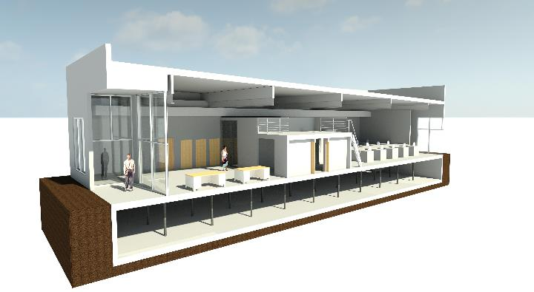
Live6 Alliance HomeBase

